Slide 1
Appreciation of English and American Literature Week 8: 19th Century Poetry
I Wandered Lonely as a Cloud – William Wordsworth
Ode on a Grecian Urn – John Keats
The Charge of the Light Brigade – Alfred, Lord Tennyson

Slide 2
Literary Devices – PRactice: Which can you identify in these short excerpts?
“… But I soon found it was impossible to avoid it; for I saw the sea come after me as high as a great hill, and as furious as an enemy which I had no means or strength to contend with;” – Robinson Crusoe
“and then many staunch knights sought to salute him,
to know how he had fared; and faithfully he tells
confessing all the cost of the cares he had suffered –”
– Sir Gawain and the Green Knight

Slide 3
Literary Devices – PRactice: Which can you identify in these short excerpts?
“…I saw the sea come after me as high as a great hill, and as furious as an enemy …”
Simile: something is like something else.
Personification: giving human attributes to something non-human.
Hyperbole: exaggeration (sometimes in a simile etc.)

Slide 4
Literary Devices – PRactice: Which can you identify in these short excerpts?
“and then many staunch knights sought to salute him,
to know how he had fared; and faithfully he tells
confessing all the cost of the cares he had suffered –”
“And sythen mony syker knyght that soght hym to haylce
Of his fare that hym frayned; and ferlyly he telles,
Biknowez alle the costes of care that he hade,”
Alliteration: sounds repeated (not necessarily the same letters).
Stress Patterns: here it is two pairs of stressed syllables.

Slide 5
Romanticism
Romanticism began around 1780, as a reaction ‘against’ the Enlightenment (‘scientific,’ ‘rational thinking’ and resultant changes), and as a move away from Neoclassicism (formal literature and art inspired by the classical period).
The Romantics emphasised imagination and subjectivity, feelings more than reason, and the countryside more than town and city life.
Wordsworth was inspired by nature (particularly the Lake District). In 1798 he and Samuel Taylor Coleridge published a book of poetry called Lyrical Ballads.

Slide 6
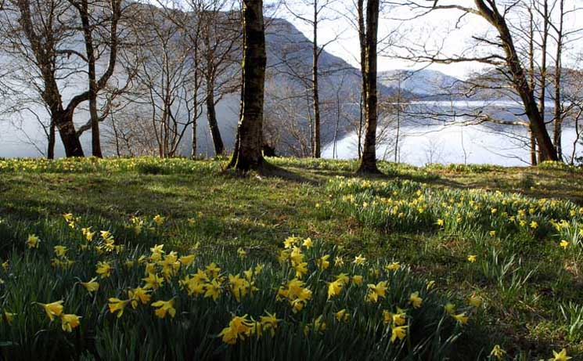
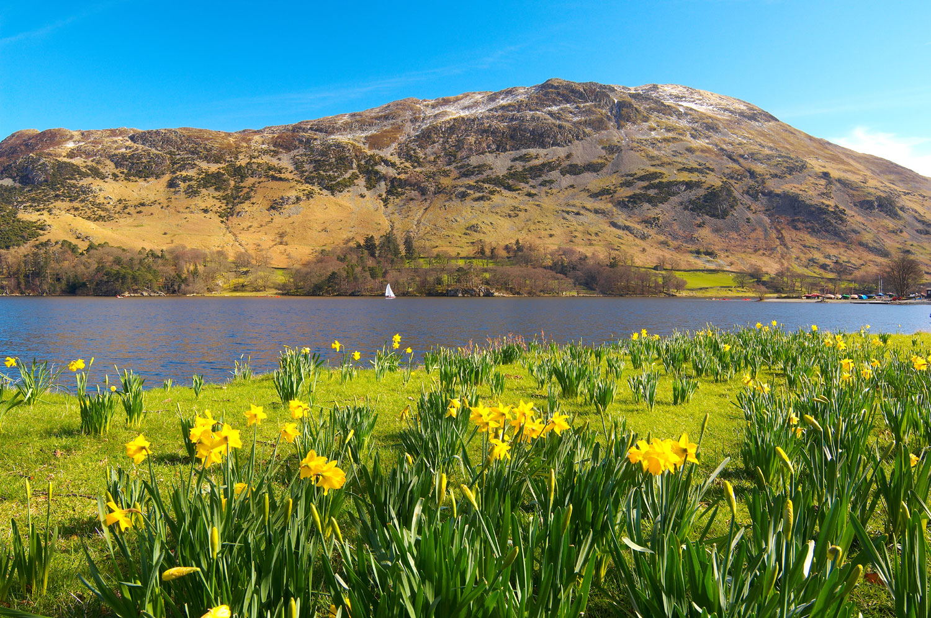
I Wandered Lonely as a Cloud (Daffodils)
William Wordsworth was walking around Ullswater Lake in The Lake District with his sister Dorothy in 1804

Slide 7
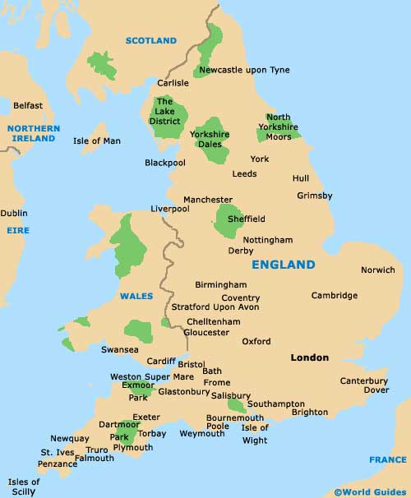
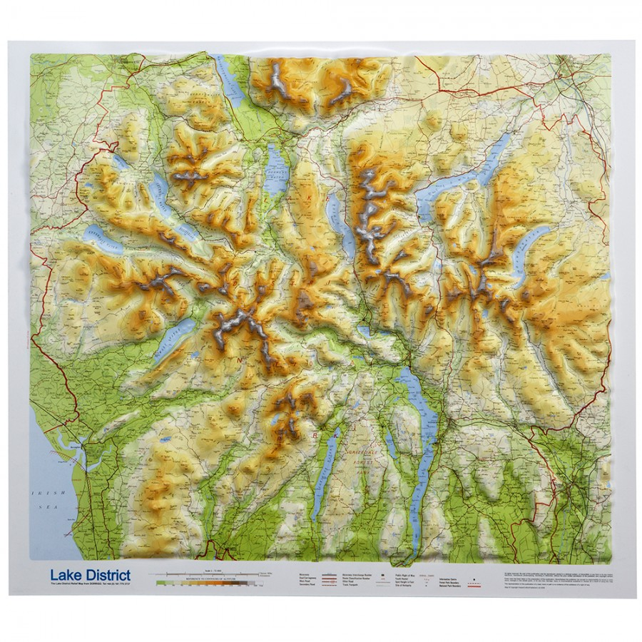
Cumbria – The Lake District

Slide 8
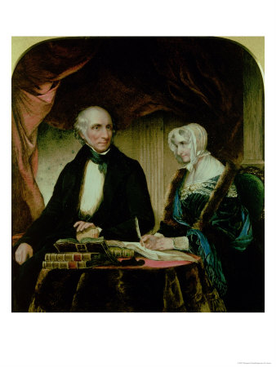
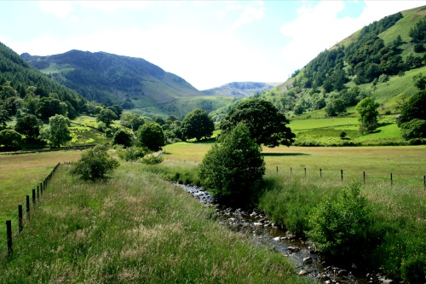
I Wandered Lonely as a Cloud (Daffodils)

Slide 9
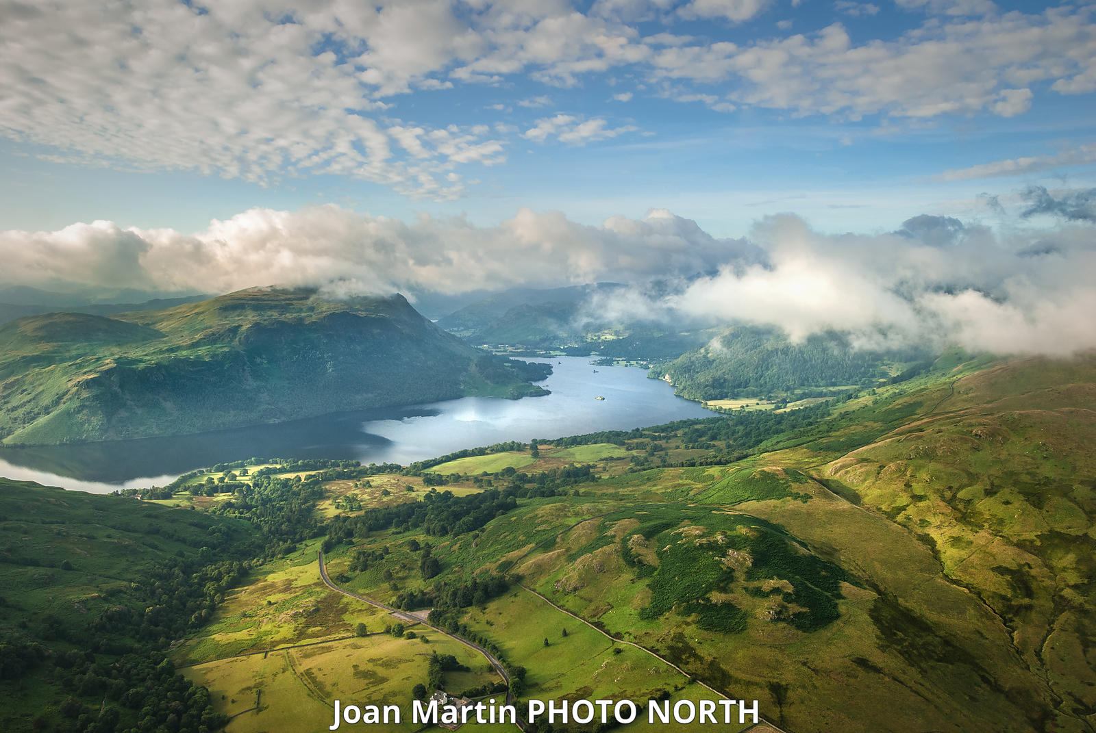
I Wandered Lonely as a Cloud (Daffodils)

Slide 10
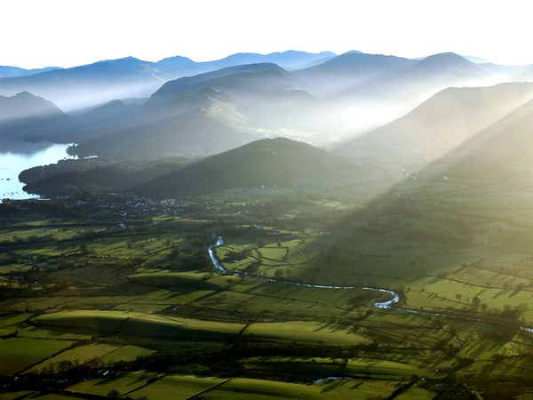
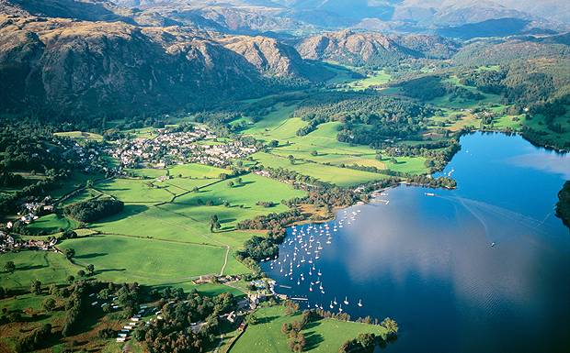
The Lake District

Slide 11
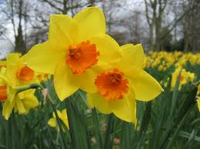
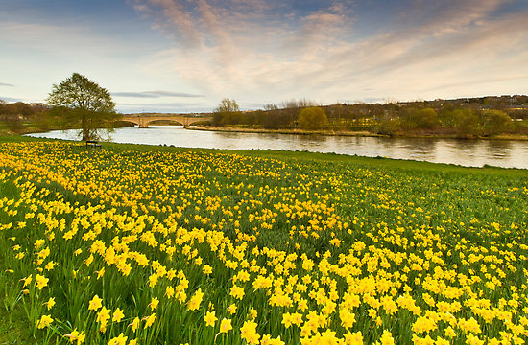
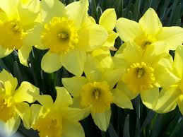
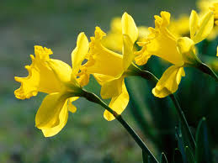
Daffodils

Slide 12
I Wandered Lonely as a Cloud (Daffodils)
Wordsworth said in the preface of Lyrical Ballads (1800 edition):
“Poetry is the spontaneous overflow of powerful feelings.”
… and that poetry is…
"the music of harmonious metrical language."

Slide 13
I Wandered Lonely as a Cloud, by William Wordsworth (1804)
I wandered lonely as a cloud
That floats on high o'er vales and hills,
When all at once I saw a crowd,
A host, of golden daffodils;
Beside the lake, beneath the trees,
Fluttering and dancing in the breeze.
How many syllables per line?
Written in Iambic tetrameter
Iamb = an unstressed syllable and a stressed syllable
Tetra = x4 (8 syllables in total)

Slide 14
I Wandered Lonely as a Cloud, by William Wordsworth (1804)
I wandered lonely as a cloud
That floats on high o'er vales and hills,
When all at once I saw a crowd,
A host, of golden daffodils;
Beside the lake, beneath the trees,
Fluttering and dancing in the breeze.
How many syllables per line?
Written in Iambic tetrameter
Iamb = an unstressed syllable and a stressed syllable
Tetra = x4 (8 syllables in total)

Slide 15
I Wandered Lonely as a Cloud, by William Wordsworth (1804)
Continuous as the stars that shine
And twinkle on the milky way,
They stretched in never-ending line
Along the margin of a bay:
Ten thousand saw I at a glance,
Tossing their heads in sprightly dance.
What is the rhyme pattern in each stanza?

Slide 16
I Wandered Lonely as a Cloud, by William Wordsworth (1804)
A
B
A
B
C
C
Continuous as the stars that shine
And twinkle on the milky way,
They stretched in never-ending line
Along the margin of a bay:
Ten thousand saw I at a glance,
Tossing their heads in sprightly dance.
What is the rhyme pattern in each stanza?
ABABCC

Slide 17

I Wandered Lonely as a Cloud (Daffodils)
Reread Wordsworth’s poem.
How does he use literary devices such as:
- Metaphor and Simile
- Personification
- Hyperbole
- Alliteration
How does he combine them with rhyme and syllable patterns?

Slide 18
I Wandered Lonely as a Cloud (Daffodils)
Alliteration:
Assonance:
Consonance:

Slide 19
I Wandered Lonely as a Cloud (Daffodils)
Alliteration: the first letter in two or more words repeats.
Assonance: the same vowel sound repeats in two or more words.
Consonance: the same consonant sound repeats in two or more words.
Find some examples of the above techniques. What effects do they have?

Slide 20
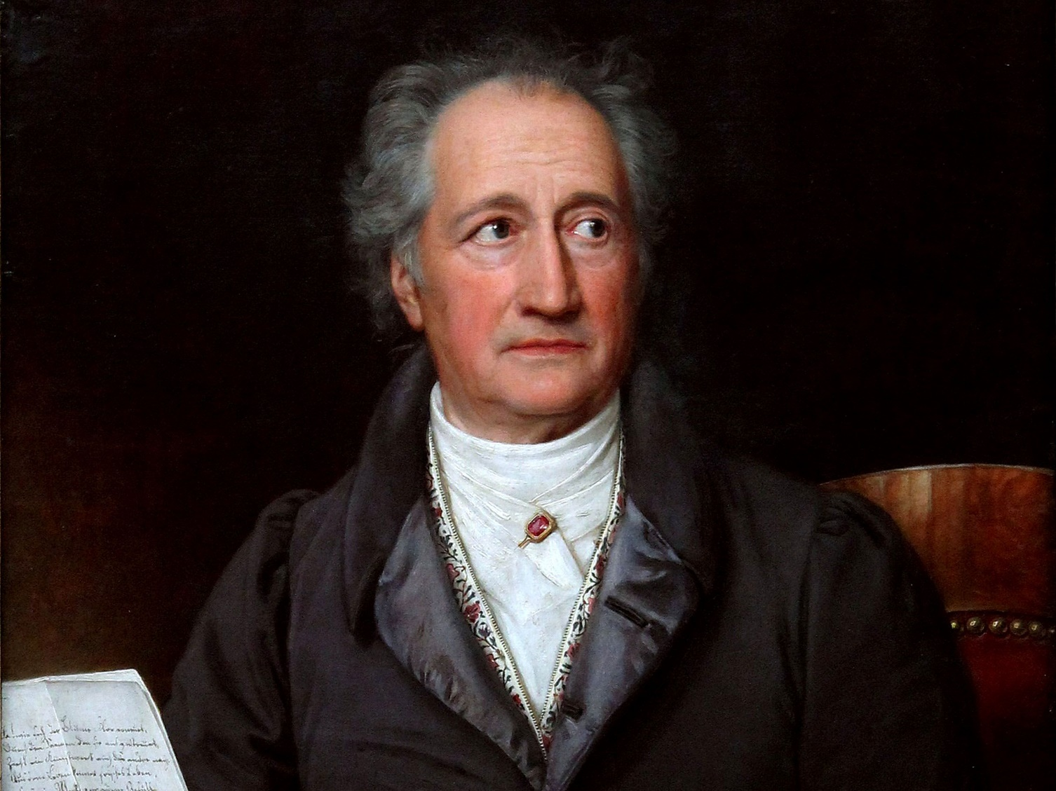
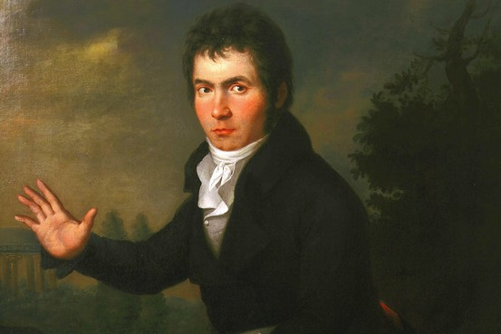
Romanticism in Europe
At the end of the 18th and turn of the 19th century, the French and American revolutions went in different directions; Napoleon tried to take over all of Europe; it was a time of disconcerting cultural change.
Johann Wolfgang von Goethe (1749-1832) was a founder/part of The Sturm und Drang literary movement (storm and stress) in ‘Germany’ (focused on expressing extreme emotions).
He became extremely famous in 1774 when he wrote his first novel, The Sorrows of Young Werther. In his later years, Goethe said the Romantic movement was “everything that is sick.”
In music, Beethoven’s powerful music bridged to the Romantic period of Chopin and Mendelssohn.
Goethe (above), and Beethoven

Slide 21
Romanticism – English poetry
First Generation of Romantic Poets: (Classical Forms; focus on nature; focus on inner spirituality.)
William Wordsworth (1779-1850); Samuel Taylor Coleridge (1772-1834).
Second Generation of Romantic Poets: (More rebellious; more nostalgia and personal emotions; idea of celebrity poets.)
Lord George Gordon ‘Byron’ (1788-1824); Percy Shelley (1792-1822);
John Keats (1795-1821).

Slide 22
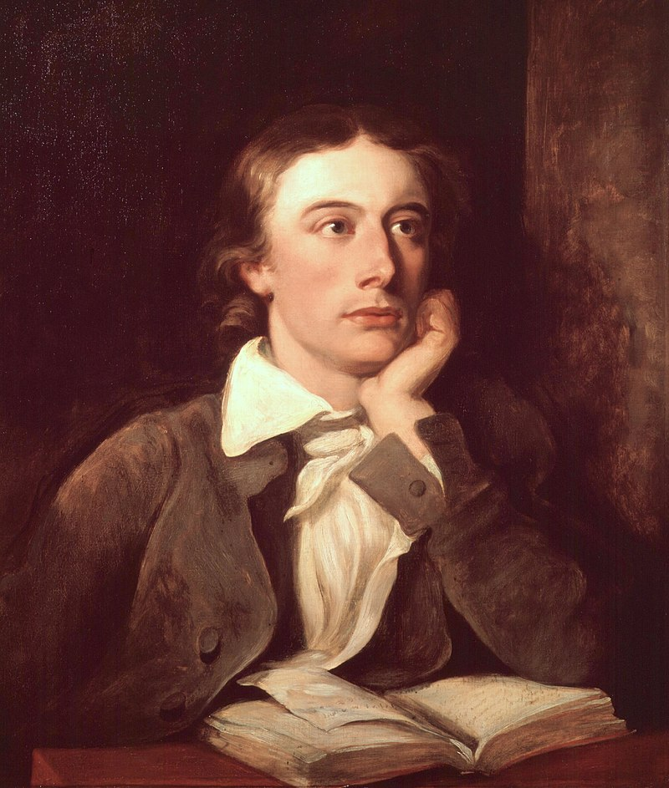
John Keats – 1795 -1821
Part of the second generation of Romantic Poets.
In his life he published little of his poetry, but after his death his poems became increasingly well-regarded.
His poetry has extremes of emotion, expressed through vivid natural imagery.

Slide 23
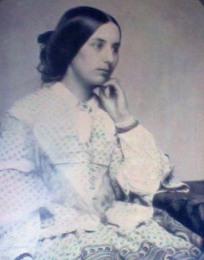
He loved Fanny Brawne, though he was a struggling poet and could not afford to marry her.
Keats caught tuberculosis and travelled to Italy for the better climate. He died five months later, in 1821, aged 25.
Fanny Brawne – circa 1850

Slide 24
From a letter written by Keats to Fanny:
"My love has made me selfish. I cannot exist without you – I am forgetful of every thing but seeing you again – my Life seems to stop there – I see no further. You have absorb'd me. I have a sensation at the present moment as though I was dissolving – I should be exquisitely miserable without the hope of soon seeing you ... I have been astonished that Men could die Martyrs for religion – I have shudder'd at it – I shudder no more – I could be martyr'd for my Religion – Love is my religion – I could die for that – I could die for you.“
Romantic? Obsessed? Idolatry? Too emotional? What ideas of truth, fact, reality, purpose… did Romantic poets have?

Slide 25
Ode on a Grecian Urn (1819) by John Keats
What is the poem about?
Keats imagines an urn (a vase or pottery from ancient Greece).
What is an ode?
A song/poem devoted to someone or something.

Slide 26
Ode on a Grecian Urn (1819) by John Keats
What does he imagine seeing painted on the Greek urn?
A rural scene; pipes and music; a romance; a pagan sacrifice.
How does Keats feel about the scene on the urn?
Nostalgia, romance, fantasy, and sad longing.
What structure and techniques does he use in the poem?
Stanza 1: ABABCDEDCE (the first four lines have a consistent rhyme pattern ABAB; the last six lines Personification, metaphor… alter slightly in different stanzas.)

Slide 27
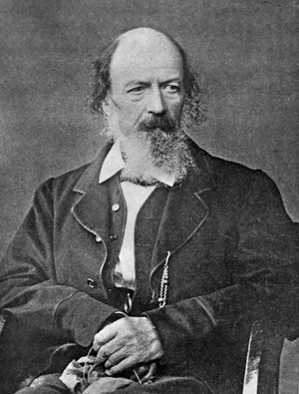
Alfred, Lord Tennyson (1809-1892)
He was born into an aristocratic family, but struggled in his younger years through family illnesses and debt, and received mixed reviews for his poetry.
He published the long poem In Memoriam in 1850 and was made ‘poet laureate’ by Queen Victoria. He married Emily, and they would have two children.
In 1855, he published Maud and Other Poems, which included The Charge of the Light Brigade.
Tennyson also wrote a long poem, The Idylls of the King (1859), about King Arthur. He became one of the most renowned figures of the Victorian era.

Slide 28
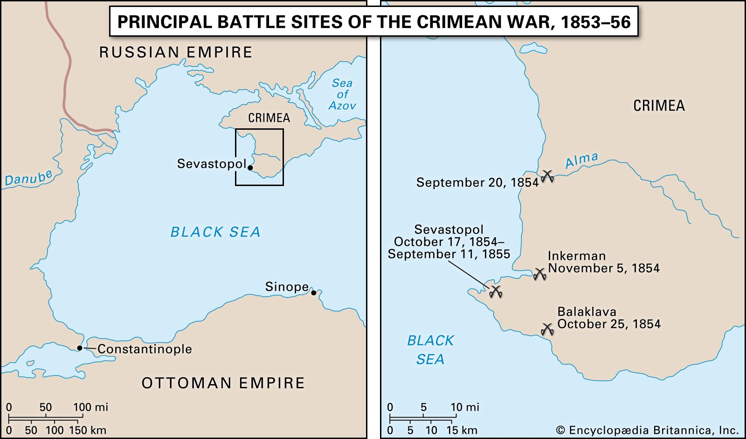
The Crimean War – 1853-6
A disagreement between the Russian and Ottoman empires broke out into a war, with the British and French supporting the Ottomans.

Slide 29
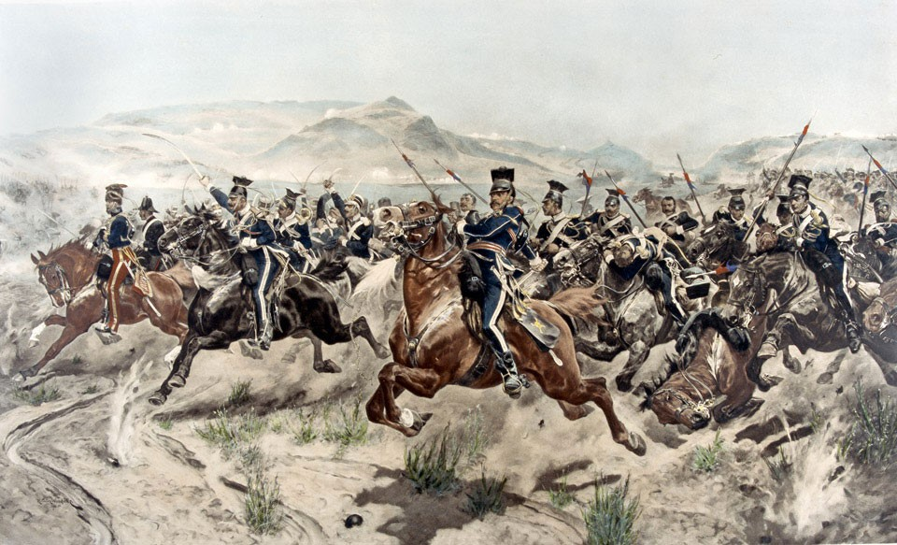
The Crimean War – 1853-6
At the battle of Balaklava, Britain’s light cavalry force was given orders to charge into a valley to make the Russians abandon their artillery guns.
Charge of the Light Brigade by Richard Caton Woodville Jr. (1894)

Slide 30
The Crimean War – 1853-6
There was possible miscommunication over the orders given.
The valley was surrounded by Russian infantry, with perhaps 30-40 canons, and Russian cavalry at its end.
Charge of the Light Brigade by Richard Caton Woodville Jr. (1894)

Slide 31
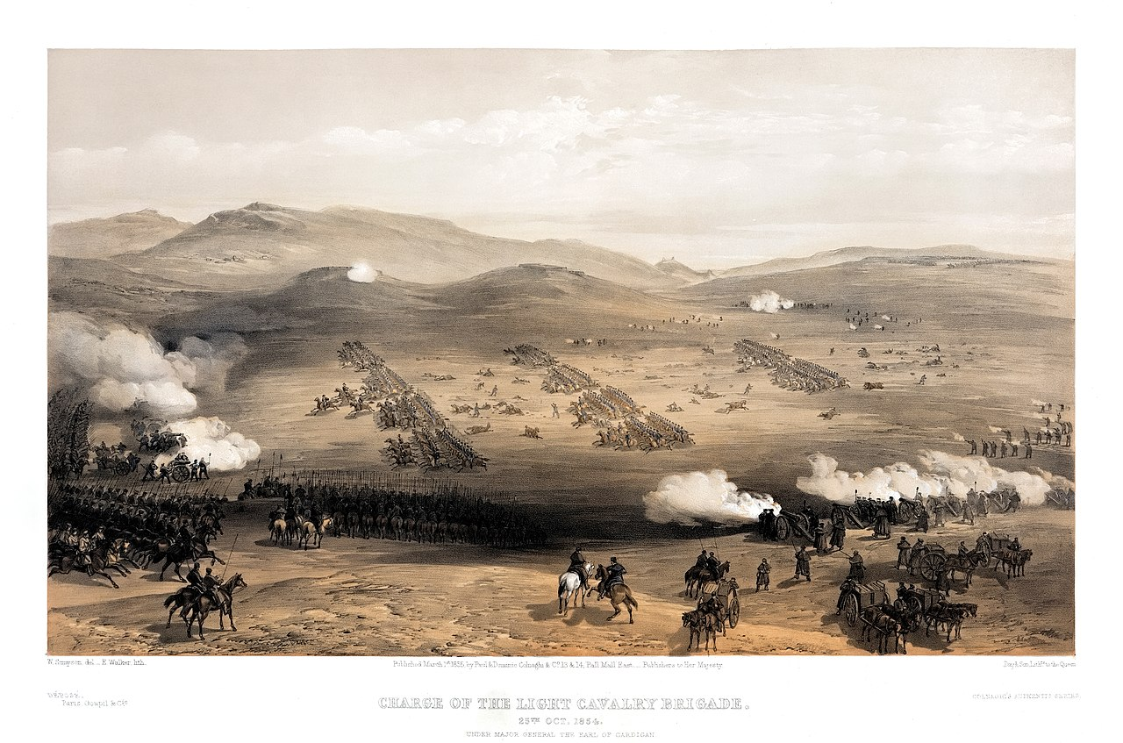
The Crimean War – 1853-6
lithograph by William Simpson (1855)
607 men charged in the brigade. 113 were killed and 143 wounded.
There was disagreement over responsibility for the orders, but the British cavalry was considered heroic.
Five weeks later, as poet laureate, Tennyson published his poem in the Examiner newspaper.

Slide 32
The Charge of the Light Brigade (1854)
I
Half a league, half a league,
Half a league onward,
All in the valley of Death
Rode the six hundred.
“Forward, the Light Brigade!
Charge for the guns!” he said.
Into the valley of Death
Rode the six hundred.
What is the ‘metre’ (the syllable rhythm of the lines)?
Where are the stressed and unstressed syllables?

Slide 33
The Charge of the Light Brigade (1854)
I
Half a league, half a league,
Half a league onward,
All in the valley of Death
Rode the six hundred.
“Forward, the Light Brigade!
Charge for the guns!” he said.
Into the valley of Death
Rode the six hundred.
Dactylic dimeter
A dactyl = STRESS unstress unstress
dimeter = two ‘feet’
The lines are uneven syllable lengths with some extra syllables and trochees.
Does it recreate the sound of the charge?

Slide 34
The Charge of the Light Brigade (1854)
II
“Forward, the Light Brigade!”
Was there a man dismayed?
Not though the soldier knew
Someone had blundered.
Theirs not to make reply,
Theirs not to reason why,
Theirs but to do and die.
Into the valley of Death
Rode the six hundred.
‘Someone had blundered’ was a line from a newspaper article about the charge.
The ‘valley of death’ references Psalm 23:4 “Even though I walk through the valley of the shadow of death, I will fear no evil.”
It’s a psalm about God as a shepherd, taking care of his sheep.

Slide 35
Writing about English literature
Which literary techniques does Wordsworth use most notably when describing the scenery in I Wandered Lonely as a Cloud?

Slide 36
Homework
American Literature:
Please read the excerpts from Little Women (1868) by Louisa May Alcott, and also watch the 2019 film adaptation (uploaded on Learning in ZJU).
Consider how the film is similar or different to the original novel.

